Slide 1
Poster Presentations
Texas A&M University-San Antonio Student Research Symposium

Slide 2
What Is a Poster?
This is a way to present your research
  People can take a quick look and then move on
  People can quickly read about the entire project
  Should catch their eyes while remaining professional

Slide 3
Why a Poster?
Posters and talks are both acceptable ways to present research.
A talk is often considered more prestigious.
  Fewer talks at a conference than posters
  Some conferences only allow attendees to present posters, and all talks are keynotes.
People who come to your talk are interested in your paper.
At a poster session, people may stop by and look at your poster even if they are not at the session to look at your research

Slide 4
How should my poster look?
There are three optional templates on the SRS website, and you may also create your own.
Please submit your poster for hanging by Wednesday, April 16 to the Office of Research & Health Sciences in CAB 405D.

Slide 5
How Do I Write On the Poster?
Use an easy-to-read font.
  Arial, Helvetica
  Not Times New Roman (better for books and papers, not posters)
Use a LARGE font.
  Not much on each slide.

Slide 6
What Do I Need to Include?
(May Vary Based on Discipline).
Title with name/affiliation
Introduction with a few sources from background literature
Hypotheses
Design/Methodology
Results with graphs/pictures
Discussion
References

Slide 7
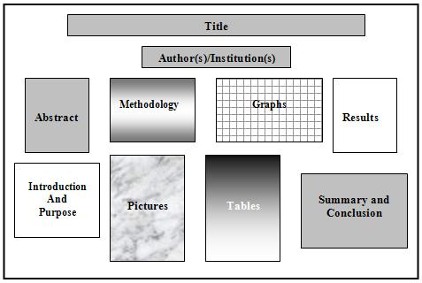
Sample Layout

Slide 8
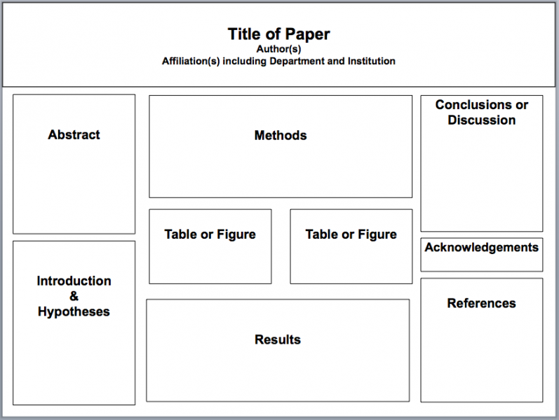
Sample Layout

Slide 9


Slide 10
Quibus simust alignamus ut que et, nobitasitat voles nonsequi aut recercia nemporem aut
logo
logo
[AUTHORS LINE] Firstname Lastname¹, Firstname Lastname², Firstname Lastname³
[DEPT./SCHOOL LINE] ¹Department of Integrative Biology, ²Department of Chemistry, College of Natural Sciences, The University of Texas, ³Suchandsuch Research Institute
Introduction
Figures and Results
Conclusion
Imintem quas porro debitis itius, nus id quat animus auda platust et imin perovitasped es ipsus mo maios eume di ut a dolupit, sequam, serio bea natis dolupta simperiae nate molorum eati ulparis magnieniam, to intotatur?
Sunto into temperi aturerum et identio nsectatem quo dolorum fuga. Itiatur, quam vendus quodis reria volupienis con posto dolor sam debit experumet odit ut id molorrum que quam fuga. Et volorioraes alit, que plitati onemporro entorio rumendi simenimus mossimus re officit mo officae etur, volorem et optae. Ut ipsam esto temquas dolores sitiandi arum ipicien debisimus doluptatius.
As verepe sectis enda di incto etusda delectet eaque simusda ndanimus, sin cori rem id maximillut hari con ea quiam quam et enduci idunt, corecta alicimp oriaeperum iusaeped unt quis et ut abor ame alis utatur as senet a quibus dolutatur sedit aliam apienda versper feriti delia pa dolo quamus arum es endellu pisquia aditatur audam
figures
figures
Research Goal
figures
figures
Ugiatempore evenis rae doluptatum fugiam earchitiam dit, tempe susdam qui asimin et quissequam la ni ipsunt.
Ditat que voluptat. Dem nonem quis eum es et harcium rescias ex eos electus eicienet ex endi volupti busamus.
Ga. Ro ium versperum re aut omnienderi sinvele stiam, cus eos sime sed que occupta temquia nobisciur? Quis dolenem oluptam ne nonessumqui doluptatem exeribus id eveliquam qui nisqui atet eiciunt.
As verepe sectis enda di incto etusda delectet eaque simusda ndanimus, sin cori rem id maximillut hari con ea quiam quam et enduci idunt, corecta alicimp oriaeperum iusaeped unt quis et ut abor ame alis utatur as senet a quibus dolutatur sedit aliam apienda versper feriti delia pa dolo quamus arum es endellu pisquia aditatur audam earupid quo quunt odigniscil earum verios nonsequam duciis et
Methods
Acknowledgments
Ga. Oviduntusam exerum fugitat quae el exersperum qui corum sam sitas que officiat am el inust dunt mint ut vel il mintis es vel maxim dolupiet, aut quatur aborem quiae explitatur sum venihit quo con cusda volorum quia qui conessunt vel etur? Quis nullitae porunto mod maiorio ex es dolupis eum
Vitam voloria con et, cum laboreium, nam cum, quat paris as core volorest, sust exceatur antio ea voluptas eumquatendit quas doluptatet aut landignam que lantur sania dem escidit min reruptiaero velis maximus aut que pe aliquas sequidisit, omnient hit lam eicias modio con nisin pediam, ent, cust accaborit odio corehen dendae nonet eliquam, aperorepe autatem voles int odic tem nis dolorrum que cores doluptaturi utemolorum imusam, idendaecabo. Nam quo
figures
figures
References
As verepe sectis enda di incto etusda delectet eaque simusda ndanimus, sin cori rem id maximillut hari con ea quiam quam et enduci idunt, corecta alicimp oriaeperum iusaeped unt quis et ut abor ame alis utatur as senet a quibus dolutatur sedit aliam apienda versper feriti delia pa dolo quamus arum es endellu pisquia aditatur audam earupid quo quunt odigniscil earum verios nonsequam duciis et apienda versper feriti delia pa dolo quamus arum es endellu pisquia aditatur audam earupid quo quunt odigniscil earum verios nonsequam
Vitam voloria con et, cum laboreium, nam cum, quat paris as core volorest, sust exceatur antio ea voluptas eumquatendit quas doluptatet aut landignam que lantur sania dem escidit min reruptiaero velis maximus aut que pe aliquas sequidisit, omnient hit lam eicias modio con nisin pediam, ent, cust accaborit odio corehen dendae nonet eliquam, aperorepe autatem voles int odic tem nis dolorrum que cores doluptaturi utemolorum imusam, idendaecabo. Nam quo moluptatur?
eicias modio con nisin pediam, ent, cust accaborit odio corehen dendae nonet eliquam, aperorepe autatem voles int odic tem nis dolorrum que

